Slide 1
Fandango movie rating discrepancy analysis
CAPSTONE PROJECT
Presented By:
1. SASIKUMAR.A-8144-Sudharsan Engineering College-Civil

Slide 2
OUTLINE
Problem Statement
Proposed System/Solution
System Development Approach
Algorithm & Deployment
Result
Conclusion
Future Scope
References

Slide 3
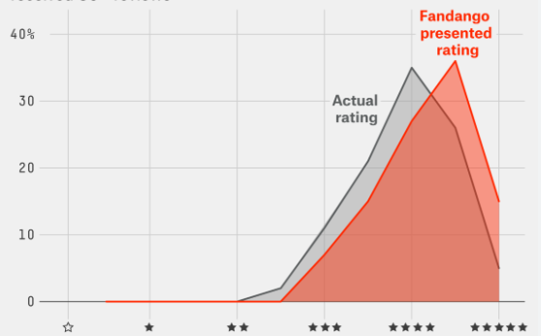
Problem Statement
Introduction to Fandango's Movie Ratings
Identification of Discrepancies: Overview of the Issue
Impact of Inaccurate Ratings on Consumers and Movie Industry
Importance of Addressing the Problem

Slide 4
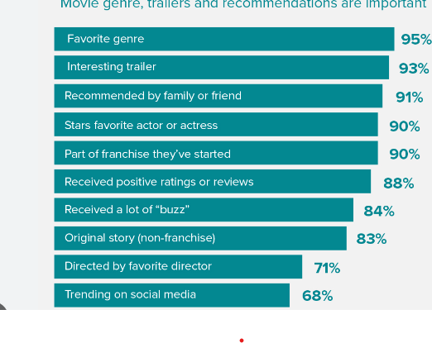
Proposed Solution
Overview of Proposed Solution: Implementing a Robust Rating System.
Incorporating Transparency and Accountability Measures
Introducing Regular Audits and Quality Checks
Engaging with Moviegoers for Feedback and Validation

Slide 5
System Approach
Agile Development Methodology: Iterative Approach for Implementation
Collaborative Efforts: Involvement of Stakeholders
Prototyping and Testing: Ensuring Effectiveness of the System
Flexibility for Future Enhancements and Adaptations

Slide 6
Algorithm & Deployment
Algorithm for Rating Calculation: Transparent and Consistent Methodology
Deployment Strategy: Gradual Rollout to Ensure Smooth Transition
Integration with Existing Systems: Compatibility and Seamlessness
Training and Support for Users and Administrators

Slide 7
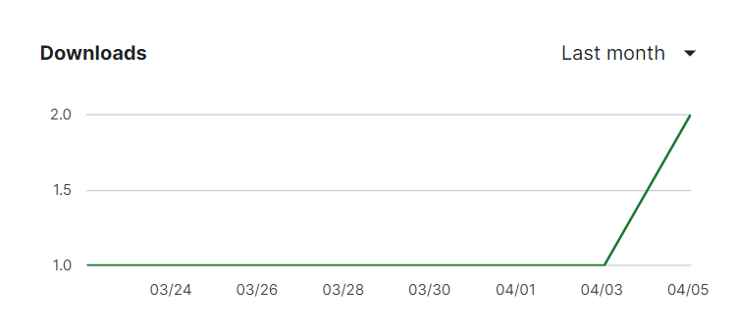
Result
Evaluation Metrics: Accuracy, Consistency, and User Satisfaction
Comparison of Pre and Post-Implementation Ratings
Feedback from Consumers and Industry Experts
Demonstrated Improvement in Rating Transparency and Reliability

Slide 8
Conclusion
Summary of Key Findings and Achievements
Importance of Addressing Rating Discrepancies for Fandango's Reputation
Acknowledgment of Challenges and Lessons Learned
Commitment to Continuous Improvement and Monitoring

Slide 9
Future scope
Potential Extensions and Upgrades to the System
Expansion of Data Analysis and Insights
Collaboration Opportunities with Industry Partners
Continued Engagement with Users for Feedback and Enhancement
Ideas

Slide 10
References
Fandango. (https://www.fandango.com/)
Rotten Tomatoes. (https://www.rottentomatoes.com/)

Slide 11
THANK YOU

